Slide 1

Project Management Information System (PMIS)
An introduction to an open-source software that provides a simple, easy-to-use project management tool

Slide 2
What is a Project Management Information System? (PMIS)
According to the Project Management Institute, a PMIS is an information system that consists of the tools and techniques used to gather, integrate, and disseminate the outputs of project management processes.*
* Project Management Institute. (2022). Process Groups: a Practice Guide. Page 288

Slide 3



Gather, Integrate, and Disseminate: Outputs of Project Management Processes
Gather
Acquire project data
Enter data into PMIS
Integrate
Information system associates the data
Disseminate
Information is compiled as reports
Reports can be exported and distributed

Slide 4
Gather, Integrate, and Disseminate: Outputs of Project Management Processes
PMI Process Groups:
Initiating:
Develop Project Charter -> Project Charter
Identify Stakeholders -> Stakeholder List
Planning: (Highlights)
Define & Sequence Activities -> Sequenced Task List
Resource Management -> Allocated Resources

Slide 5
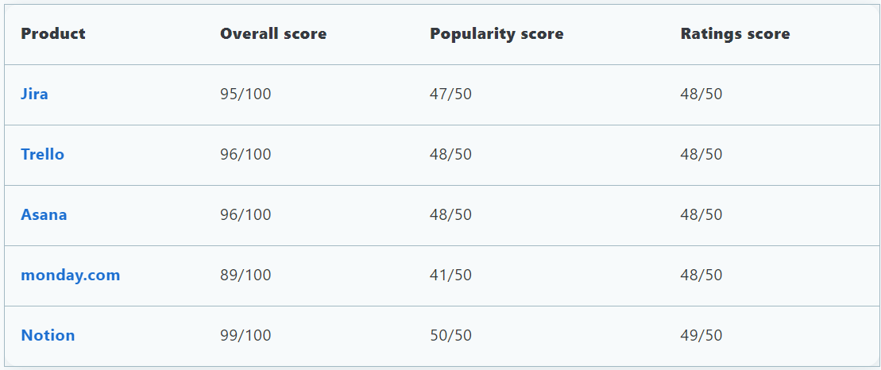
Existing PMIS
Many services like Jira, Trello, Asana, and others, require costly subscriptions and are mostly aligned with Agile project management styles.
These services also require Internet connectivity and accounts to utilize their services.
Capterra, a vendor research organization, ranks PMIS by surveying customers of well-known vendors *
Capterra: https://www.capterra.com/project-management-software/

Slide 6
PMIS As Open-Source Software
Open-source software is:
Different from the web application software deployed by large vendors
Often developed by invested community members or professionals in the field related to the purpose of the software
Ready out of the box- no accounts, licenses, or fees
Simple to deploy across an organization
You could use open-source software as your PMIS
Avoid licensing
Potentially free software
No accounts required

Slide 7
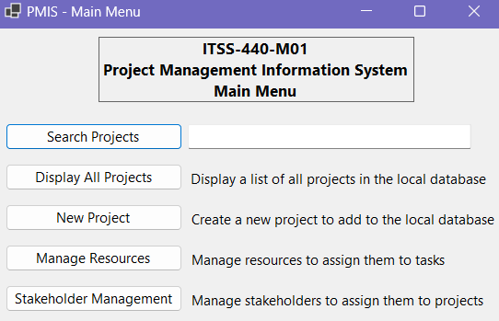
Open-source Software: A project management information system
Using this open-source PMIS allows project managers to quickly manage project data
Record project data like requirements & milestones
Maintain stakeholder and resource lists
Assign stakeholders and resources to projects and tasks
Define and sequence tasks
Generate reports: project charter and sequenced task list

Slide 8
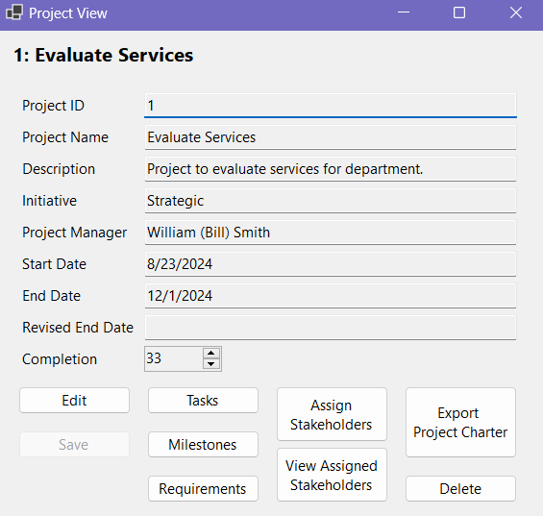
Gather, Integrate, and Disseminate: Open-Source PMIS Solution
Gather
• Acquire project data
• Enter data into PMIS
Project managers can quickly view, add, edit, and delete project data
Simplified menu allows project managers to perform all basic actions from a single root menu

Slide 9
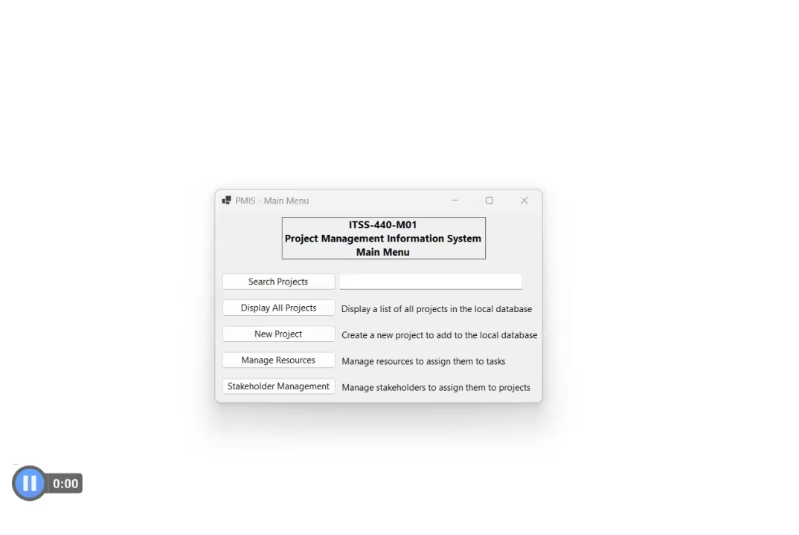

Slide 10
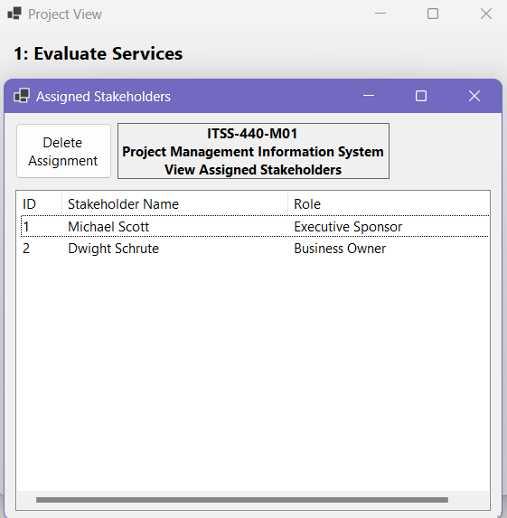
Gather, Integrate, and Disseminate: Open-Source PMIS Solution
Integrate
Information system associates the data
Data is associated to projects by the underlying database
The database is nearly invisible to the user of the application
Menus to assign stakeholders and resources allow the project manager to select stakeholders and resources through simplified menus
Resource and stakeholder assignments, tasks, milestones, and requirements are associated to the project for full integration of project data

Slide 11
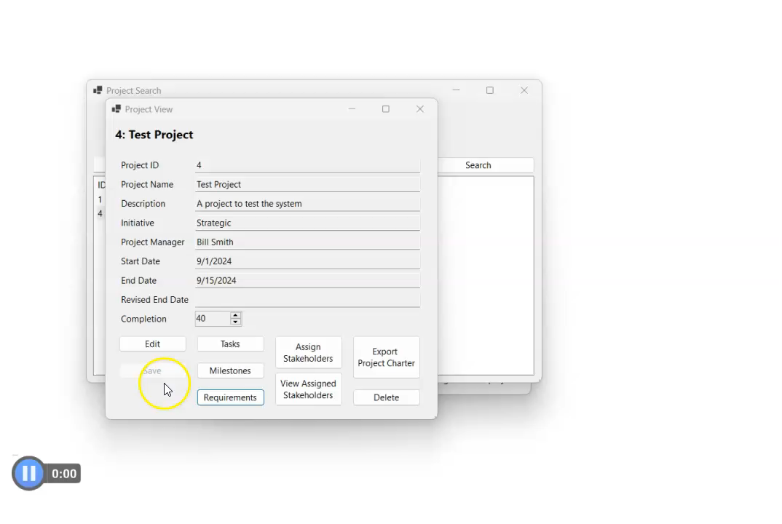

Slide 12
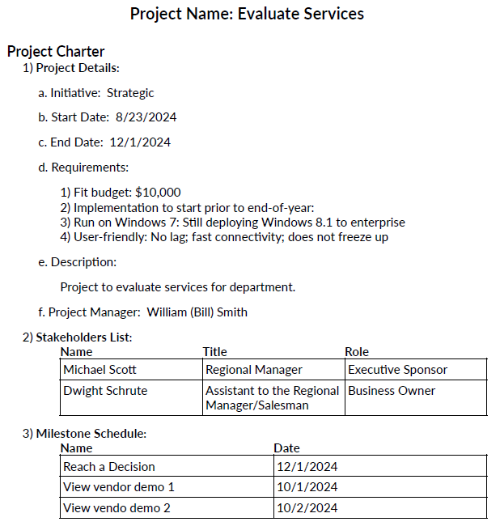
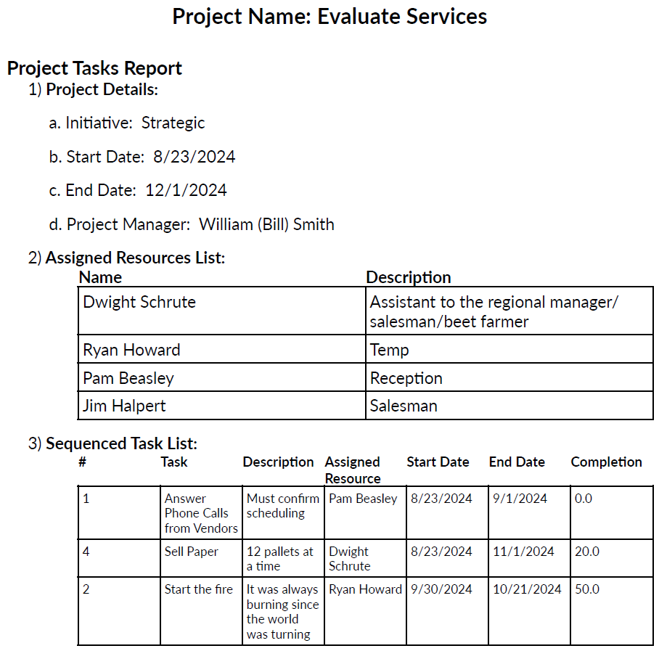
Gather, Integrate, and Disseminate: Open-Source PMIS Solution
Disseminate
Information is compiled as reports for distribution
• Simplified document export at the click of a button
• Export information as a PDF to easily share project documents

Slide 13
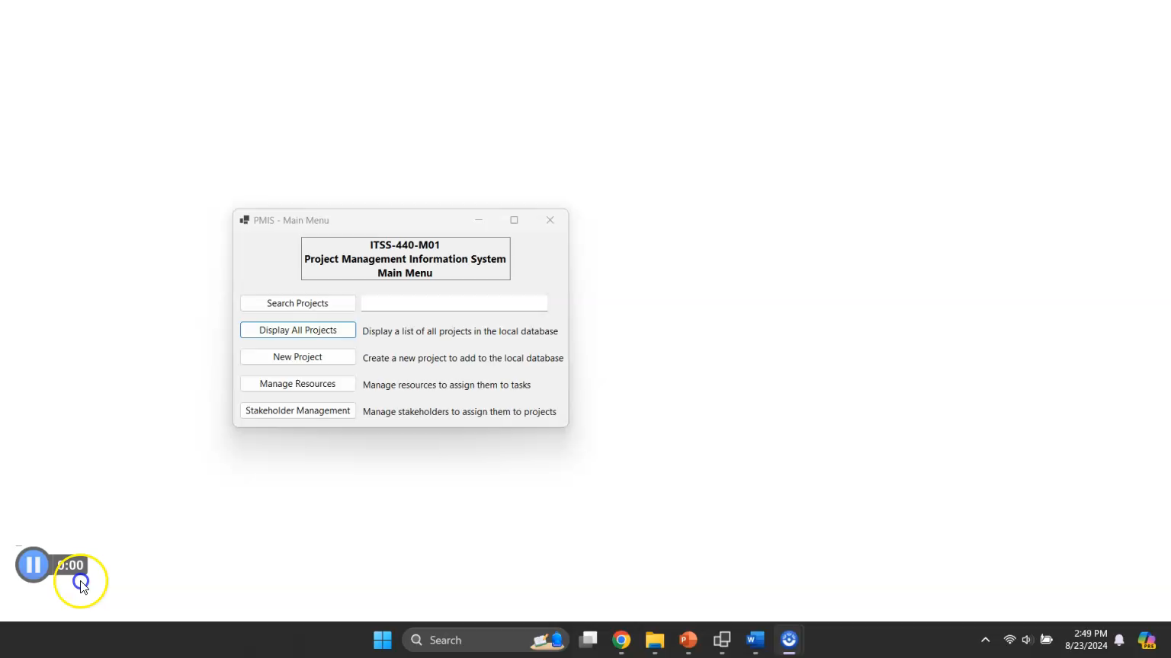

Slide 14
Review: Open-source Project Management Information System
A PMIS is an information system that consists of the tools and techniques used to gather, integrate, and disseminate the outputs of project management processes
Existing PMIS are costly, require licensing, must maintain internet connection to manage projects, and require accounts
This open-source PMIS provides value by being free, easy to use, and set up in moments
This open-source PMIS meets all the major goals of a PMIS as described by the Project Management Institute

Slide 15
Open-Source Project Management Information System (PMIS) ITSS-440-M01
Download the free software here:
https://github.com/JordanWhitehead/ITSS-440-M01-PMIS

